Slide 1
CONTAINMENT ZONE ALERTING APPLICATION
PROBLEM STATEMENT

Slide 2
TEAM DETAILS
TEAM LEADER : MANIKANDAN.P
MEMBERS : ROJA.M
PARTHIBAN.S
SABARI.M

Slide 3
PROJECT IDEA :
THIS APPLICATION IS INTENDED TO PROVIDE INFORMATION ABOUT CONTAINMENT ZONES IN A PARTICULAR REGION BY ALERTING PEOPLE , THROUGH CONTINUOUS MONITORING OF AN INDIVIDUAL LOCATION.
KEY BENEFITS OF THE APPLICATION ARE MONITORING PEOPLE’S ACTIVITY AND ALERTING THEM OF THEIR SAFETY MOVEMENTS.

Slide 4
PROBLEM STATEMENT : DEFINITION
A PROBLEM STATEMENT IS A CONCISE DESCRIPTION OF THE PROBLEM OR ISSUES A PROJECT SEEKS TO ADDRESS.THE PROBLEM STATEMENT IDENTIFIES THE CURRENT STATE , THE DESIRED FUTURE STATE AND ANY GAPS BETWEEN THE TWO.
A PROBLEM STATEMENT IS AN IMPORTANT COMMUNICATION TOOL THAT CAN HELP ENSURE EVERYONE WORKING ON A PROJECT KNOWS WHAT THE PROBLEM THEY NEED TO ADDRESS IS AND WHY THE PROJECT IS IMPORTANT.

Slide 5
PROBLEM STATEMENTS :
HOW TO DEAL WITH WITH PANDEMIC CHALLENGES ?
WHAT ARE THE WAYS TO BE SAFE ?
HOW TO AVOID DISEASE SPREAD ?
WHAT ARE THE ALTERNATE IDEAS ?
IS THE APP IS REALIABLE & HELPFUL ?
HOW TO DO SELF – ANALYSE ?
WHAT TO DO IN EMERGENCY SITUATIONS ?

Slide 6
PROBLEM STATEMENTS :
SAFETY OF PEOPLE’S & CONTROL THE DISEASE SPREAD IS MAIN TASK.
HELPING SUFFERED PEOPLE’S IN PANDEMIC SITUATIONS SHOULD PROPERLY DONE.
ALL TYPES OF SUPPORTS SHOULD REACHABLE TO PROPLE’S.
THE PRIVACY OF USERS SHOULD VALUED.
USER DETAILS SHOULD PROTECTED BY HIGHER SECURITY.
DATA’S AND STATICS SHOULD BE TRUTH.

Slide 7
SOLUTIONS :
THE PROJECT AIMS AT BUILDING AN APPLICATION THAT PROVIDES INFORMATION ABOUT THE CONTAINMENT ZONES OF A PARTICULAR REGION BY CONTINUOUSLY MONITORING AN INDIVIDUAL’S LOCATION.
LOCATION OF THE INDIVIDUAL MUST BE STORED IN THE DATABASE .
ALERTS ARE SENT USING THE NOTIFICATION SERVICE.

Slide 8
FUNCTIONS :
CONTACT TRACING
SYMPTOM TRACKING
NEWS & INFORMATION
CUSTOMER SUPPORT SERVICE
ALERT SYSTEM
UPDATE SYSTEM

Slide 9
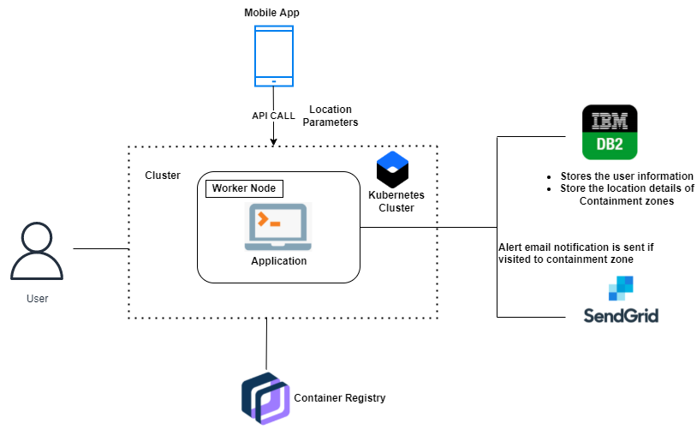






TECHNICAL ARCHITECTURE :

Slide 10

Q & A :
HOW USERS ARE CONTACTED IF THEY ARE IN CLOSE CONTACT WITH SOMEONE WHO AFFECTED BY DISEASE ?
ANS : THE APP SENDS AN IN-APP NOTIFICATION WHEN THE APP IDENTIFIES THAT A USER HAS BEEN IN CLOSE CONTACT WITH CONFIRMED CASE.
IS THIS APP RUNNNING IN BACKGROUND ALWAYS ?
ANS : YES ,THIS APP WILL RUN ON BACKGROUND.
IS SELF - DIAGONISE CAN DONE WITH HELP OF THIS APP ?
ANS : YES, USERS CAN SELF – DIAGONSE WITH HELP OF THIS APP.

